Slide 1

RAPID APPLICATION DEVELOPMENT
The 6769 Team

Slide 2
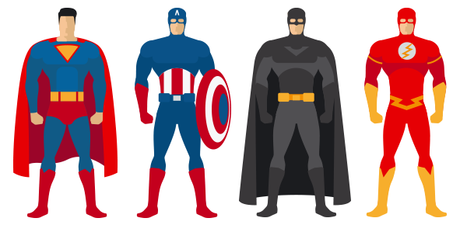
THE 6769 TEAM
TRẦN LÊ VĨNH HUY – LEADER + DEVELOPER
LÊ CÔNG PHA – DEVELOPER
NGUYỄN NGỌC TẤN TÀI – DEVELOPER
NGUYỄN VĂN HIẾU – DESIGNER

Slide 3

HISTORY

Slide 4


PLAN-DRIVEN APPROACHES
Attempt to rigidly define the requirements, the solution, and the plan to implement it, and have a process that discourage changes.

Slide 5
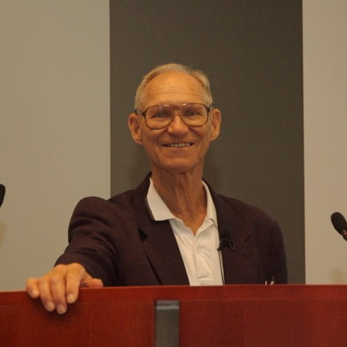

PIONEERS
Developed and published a book in 1991, Rapid Application Development.
Developed the spiral model.
Barry W. Boehm
James Martin

Slide 6
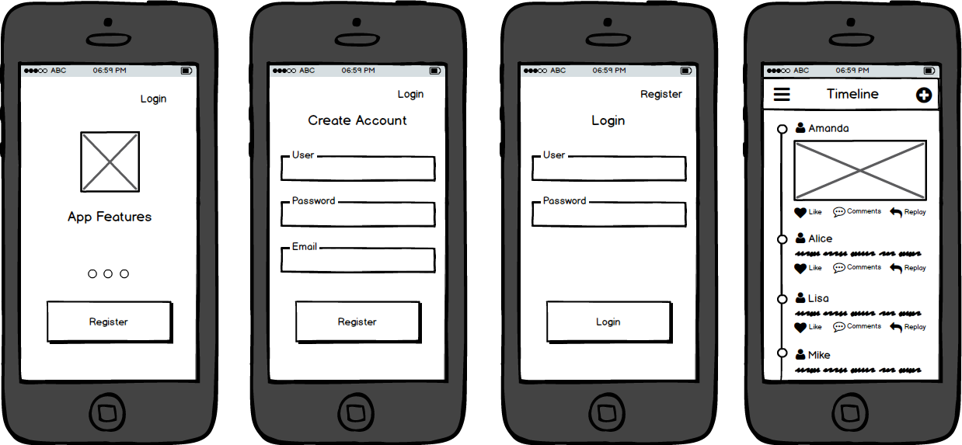
PROTOTYPES
RISK REDUCTION
USERS USE PROTOTYPES THEN REACT
CAN INVOLVE INTO COMPLETED PRODUCT

Slide 7
METHOD
REQUIREMENTS PLANNING
USER DESIGN
CONSTRUCTION
CUTOVER

Slide 8


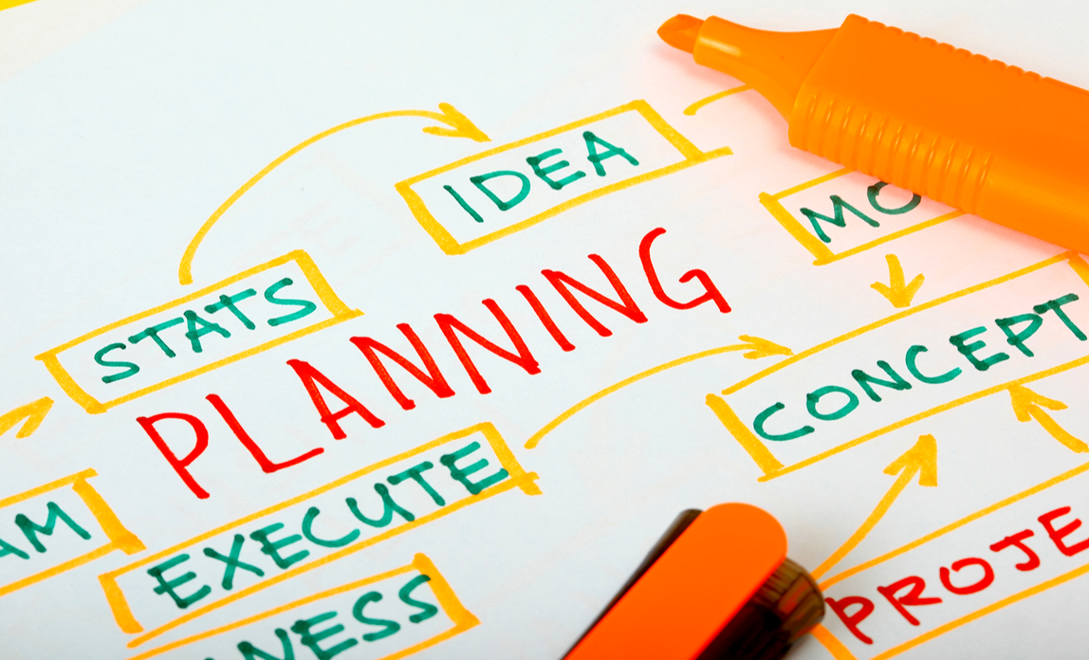
REQUIREMENTS PLANNING
REQUIREMENTS PLANNING
USERS, MANAGERS, IT STAFF MEMBERS
BASIC PLAN
AGREEMENT

Slide 9

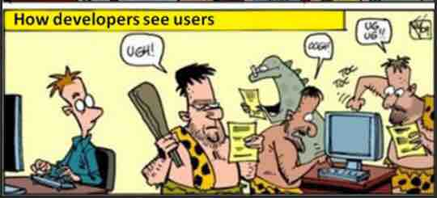
USER DESIGN
USER DESIGN
RAD TEAM
PROTOTYPES

Slide 10

CONSTRUCTION
CONSTRUCTION

Slide 11
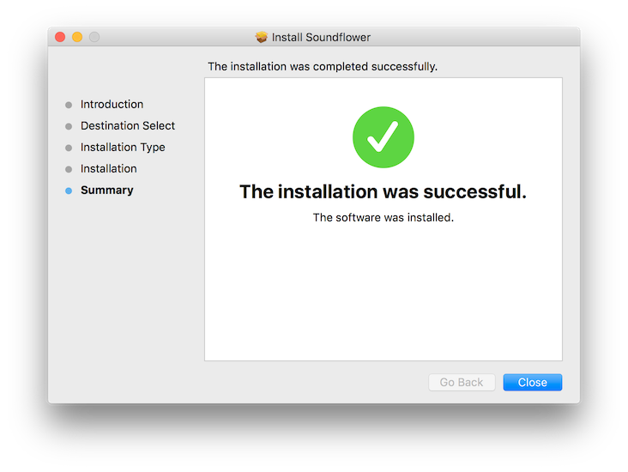

CUTOVER
CUTOVER
DATA CONVERSION, TESTING, CHANGE OVER TO THE NEW SYSTEM,…
USER TRAINING

Slide 12
REQUIREMENTS PLANNING
USER DESIGN
CONSTRUCTION
CUTOVER

